Slide 1
Wrangle that data with R

Slide 2
Loops (For loop )
A loop is a way to repeat a sequence of instructions under certain conditions.
They allow you to automate parts of your code.

Slide 3
for(varname in seq){
statement(s)
}
for(i in 1:10){
print(i)
}

Slide 4


Slide 5
Nested loops
num_vector <- c(1,2,3)
alpha_vector <- c('a', 'b', 'c')
for (num in num_vector) { # outer loop
print(num)
for (letter in alpha_vector){ # inner loop
print(letter)
}
}

Slide 7
While loop
i <- 1
while (i < 6) {
print(i)
i <- i + 1
}

Slide 8
While loop (example using a data frame)
value <- c(19,60,82,72,26)
group <- c('A','B','C','D','E')
df<-data.frame(group,value)
cnt <- 1
growth<-.06
while (cnt < length(df)) {
df$new_value<-df$value*(1+growth)
cnt = cnt + 1
}

Slide 10
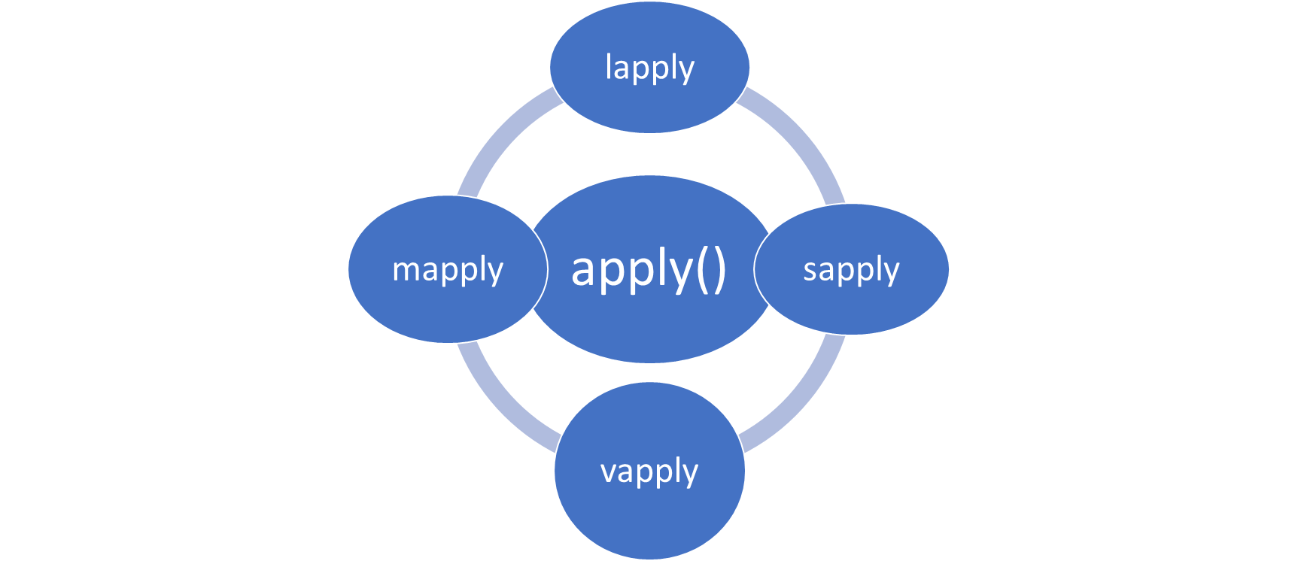
Apply Family – Alternative to Loops

Slide 11
APPLY() , SAPPLY(), LAPPLY()
"apply" returns a vector or array or list of values obtained by applying a function to margins of an array or matrix.
"lapply" returns a list of the same length as X, each element of which is the result of applying FUN to the corresponding element of X.
"sapply" is a user-friendly version of lapply by default returning a vector or matrix if appropriate.

Slide 12
APPLY()
apply(X, MARGIN, FUN)
-x: an array or matrix
-MARGIN: take a value or range between 1 and 2 to define where to apply the function:
-MARGIN=1`: the manipulation is performed on rows
-MARGIN=2`: the manipulation is performed on columns
-MARGIN=c(1,2)` the manipulation is performed on rows and columns
-FUN: tells which function to apply. Built functions like mean, median, sum, min, max and even user-defined functions can be applied>

Slide 13
LAPPLY()
lapply(X, FUN)
Arguments:
-X: A vector or an object
-FUN: Function applied to each element of x

Slide 14
SAPPLY()
sapply(X, FUN)
Arguments:
-X: A vector or an object
-FUN: Function applied to each element of x
does the same job as lapply() function but returns a vector

Slide 15

Exercise

Slide 16
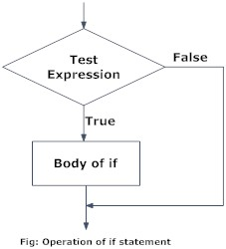
Conditional statements
if (test_expression) { statement }

Slide 17
Conditional statements
The if() Statement
The if() statement is common in all programming languages. The if() statement performs operations based on a simple condition:

Slide 18
Conditional statements
With data frames use ifelse(df$x>3,0,1)
df<-data.frame(cbind(x,y))
df$x<-ifelse(df$x > 7, 5,0)
df$x

Slide 19
Exercise

Slide 20
Tydiverse
6.

Slide 21

Tidyverse
The tidyverse is an opinionated collection of R packages designed for data science. All packages share an underlying design philosophy, grammar, and data structures.

Slide 22


Tidyverse

Slide 23
Dplyr and the %>% operator
%>%
allows you to pipe the output from one function to the input of another function. Instead of nesting functions (reading from the inside to the outside), the idea of piping is to read the functions from left to right.

Slide 24
%>% operator
Data frame
head(select(msleep, name, sleep_total))
msleep %>% select(name, sleep_total) %>% head()
Data frame

Slide 25
dplyr
a grammar of data manipulation, providing a consistent set of verbs that help you solve the most common data manipulation challenges:
mutate() adds new variables that are functions of existing variables
select() picks variables based on their names.
filter() picks cases based on their values.
summarise() reduces multiple values down to a single summary.
arrange() changes the ordering of the rows.

Slide 26
tidyr
pivot_longer() | Pivot data from wide to long
pivot_wider() | Pivot data from long to wide
spread() | Spread a key-value pair across multiple columns
gather() | Gather columns into key-value pairs

Slide 27
Exercise

Slide 28
Combined tables

Slide 29
Vocabulary
Concatenation: involves combing tables from side to side
Merge: involves combing tables from side to side using a key variable
Append: involved combing tables from top to bottom.

Slide 30
cbind() – for columns
x<-runif(3,1,10)
y<-runif(3,1,10)
cbind(x,y)

Slide 31
rbind()- for rows
x<-runif(3,1,10)
y<-runif(3,1,10)
rbind(x,y)
join two data frames (datasets) vertically- appending

Slide 32
Merge
merge(df1, df2, by=“key")

Slide 33
Joins
Natural join: To keep only rows that match from the data frames
Full outer join: To keep all rows from both data frames
Left outer join: To include all the rows of your data frame x and only those from y that match
Right outer join: To include all the rows of your data frame y and only those from x that match

Slide 34
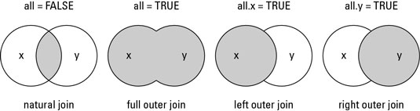
Joins

Slide 35
Joins
outer join: merge(buildings, data, by="location", all=TRUE)
left join: merge(buildings, data, by="location", all.x=TRUE)
right join: merge(buildings, data, by="location", all.y=TRUE)

Slide 36
Exercise

Slide 37
SQL- Structured Query Language
standardized programming language used for managing relational databases and performing various operations on the data in them.

Slide 38
SQL- Structured Query Language
Basics syntax:
SELECT- select observations/records
FROM- the data set or database
WHERE- conditional statement

Slide 39
SQL- Structured Query Language
Packages: sqldf PASWR
sqldf("select count(*) from dataframe")

Slide 40
Exercise

Slide 41

BONUS

Slide 42
Missing Observations

Slide 43
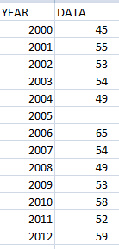
Missing observations
A situation where no value is stored in an observation (element/cell) within a variable.
This is a common occurrence that is present whenever analyzing data or creating statistical models (either computationally or visually).
?

Slide 44
Missing observations
Why is this important?
Most statistical procedures require a complete set of estimates for each variable.
Missing data may distort inferences about the population being analyzed
When the data set is incomplete the data analyst, researcher, or scientist needs to figure out how to deal with it
Document your steps as others will want to know- reproducibility purposes!!

Slide 45
Missing observations
3 kinds of missing data
missing completely at random (MCAR)
missing at random (MAR)
missing not at random (MNAR)

Slide 46
Missing observations
missing not at random (MNAR)
- missing data is related to values of any variable

Slide 47
Missing observations
Other reason why data is missing- Data suppressions.
Suppression of particular data values generally creates data that are missing not at random

Slide 48

Missing Data
What do they look like?
“.”
“NA”
“NaN” : means not a number

Slide 49
Steps when dealing with missing values
Test for missing values
Recode missing values
Remove missing values

Slide 50
Exercise

Slide 51
Methods of fixing missing observations
Listwise deletion
Recover the value
Educated guess
Average, median**
Interpolation**
Extrapolation*
**recommend method
*recommend method with caution

Slide 52
Methods of fixing missing observations
Listwise deletion
x <- c(1,2,NA,3)
#removing missing observation
mean(x, na.rm=TRUE)
median(x, na.rm=TRUE)

Slide 53
Methods of fixing missing observations
Educated guess- not the preferred choice but it is still an option.

Slide 54
Methods of fixing missing observations
Average, median, or impute**
library(timeSeries)
## Subsitute NA's with Zeros or the column mean or median
substituteNA(data, type = "zeros")
substituteNA(data, type = "mean")
substituteNA(data, type = "median")
**recommend method

Slide 55
Methods of fixing missing observations
Average, median, or impute**
library(Hmisc)
impute(data$DATA, mean) # replace with mean
impute(data$DATA, median) # median
impute(data$DATA, 20) # replace specific
**recommend method

Slide 56
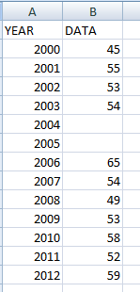
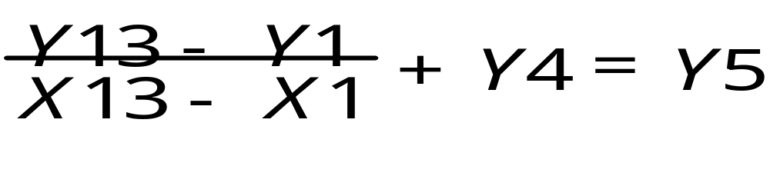
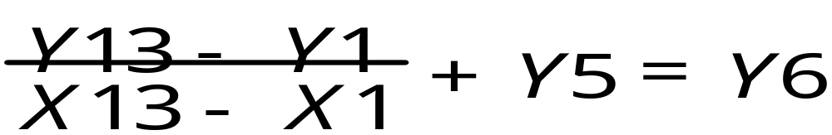
Fixing missing observations in R
Interpolation **- finding missing values within a set of data.
Y is the DATA value
X is the YEAR
Notes:
**recommend method

Slide 57
Fixing missing observations in R
Interpolation**- finding missing values within a set of data.
library(timeSeries)
interpNA(x, method = "linear")
library(imputeTS)
na.interpolation(x, option = "linear")
na.interpolation(x, option = "splin")

Slide 58
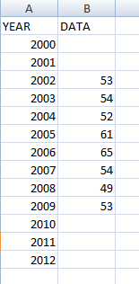
Fixing missing observations
Extrapolation*- finding values outside of the known values (either forward or backwards)
*recommend method with caution

Slide 59
Exercise

Slide 60
Review

Slide 61
Thank you

